Slide 1
Quantization-aware Training (QAT)

Slide 2
Quantization
Post-training Quantization
Quantization-aware Training

Slide 3
Quantization
Post-training Quantization
Quantization-aware Training

Slide 4
 | Floating-point Baseline
MobileNet v1 1.0 224 | 71.03%
MobileNet v2 1.0 224 | 70.77%
Resnet v1 50 | 76.30%

Slide 5
 | Floating-point Baseline | Post-training Quantization (PTQ)
MobileNet v1 1.0 224 | 71.03% | 69.57%
MobileNet v2 1.0 224 | 70.77% | 70.20%
Resnet v1 50 | 76.30% | 75.95%

Slide 6
 | Floating-point Baseline | Post-training Quantization (PTQ) | Accuracy Drop
MobileNet v1 1.0 224 | 71.03% | 69.57% | ▾1.46%
MobileNet v2 1.0 224 | 70.77% | 70.20% | ▾0.57%
Resnet v1 50 | 76.30% | 75.95% | ▾0.35%

Slide 7
Is this accuracy drop tolerable?

Slide 8
Quantization
Post-training Quantization
Quantization-aware Training

Slide 9
Quantization
Post-training Quantization
Quantization-aware Training
Quantization aware training emulates inference-time quantization, creating a model that downstream tools will use to produce actually quantized models. The quantized models use lower-precision (e.g. 8-bit instead of 32-bit float), leading to benefits during deployment.

Slide 10
Why does the accuracy drop?
Notes:
https://upload.wikimedia.org/wikipedia/commons/2/22/Quanterr.png

Slide 11
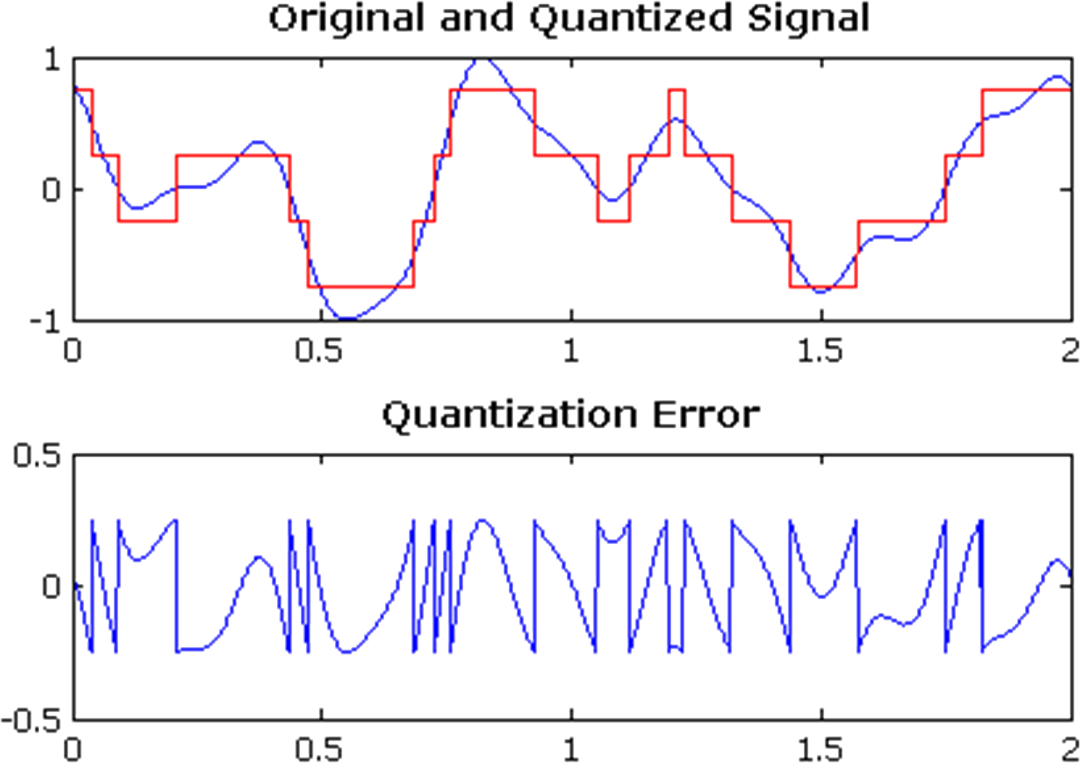
Why does the accuracy drop?
Introducing error by discretizing the values
Notes:
https://upload.wikimedia.org/wikipedia/commons/2/22/Quanterr.png
https://commons.wikimedia.org/wiki/File:Quanterr.png

Slide 12
Why does the accuracy drop?
Introducing error by discretizing the values
Quantized weights are in int8 instead of fp32
Notes:
https://upload.wikimedia.org/wikipedia/commons/2/22/Quanterr.png
https://commons.wikimedia.org/wiki/File:Quanterr.png

Slide 13
Why does the accuracy drop?
Introducing error by discretizing the values
Quantized weights are in int8 instead of fp32
Many different conversions (computation: int8, accumulations: int32, rescaling: int8)
Notes:
https://upload.wikimedia.org/wikipedia/commons/2/22/Quanterr.png
https://commons.wikimedia.org/wiki/File:Quanterr.png

Slide 14
Quantization-aware Training
ReLU6
act quant
output
Mimic the inference path during the training phase
+
biases
conv
input
wt quant
weights
Notes:
https://blog.tensorflow.org/2020/04/quantization-aware-training-with-tensorflow-model-optimization-toolkit.html

Slide 15
Quantization-aware Training
ReLU6
act quant
output
Mimic the inference path during the training phase
Expose the training pipeline to the errors observed
+
biases
conv
input
wt quant
weights
Notes:
https://blog.tensorflow.org/2020/04/quantization-aware-training-with-tensorflow-model-optimization-toolkit.html

Slide 16
Quantization-aware Training
ReLU6
act quant
output
Mimic the inference path during the training phase
Expose the training pipeline to the errors observed
Allow the training phase to recover the error “naturally”
+
biases
conv
input
wt quant
weights
Notes:
https://blog.tensorflow.org/2020/04/quantization-aware-training-with-tensorflow-model-optimization-toolkit.html

Slide 17
Quantization-aware Training
ReLU6
act quant
output
Mimic the inference path during the training phase
Expose the training pipeline to the errors observed
Allow the training phase to recover the error “naturally”
Weights and inputs use the same int8—mimic int8 MAC
+
biases
conv
input
wt quant
weights
Notes:
https://blog.tensorflow.org/2020/04/quantization-aware-training-with-tensorflow-model-optimization-toolkit.html

Slide 18
 | Floating-point Baseline | Post-training Quantization (PTQ) | Quantization-Aware Training (QAT)
MobileNet v1 1.0 224 | 71.03% | 69.57% | 71.06%
MobileNet v2 1.0 224 | 70.77% | 70.20% | 70.01%
Resnet v1 50 | 76.30% | 75.95% | 76.10%

Slide 19
 | Floating-point Baseline | Post-training Quantization (PTQ) | Quantization-Aware Training (QAT)
MobileNet v1 1.0 224 | 71.03% | 69.57% | 71.06%
MobileNet v2 1.0 224 | 70.77% | 70.20% | 70.01%
Resnet v1 50 | 76.30% | 75.95% | 76.10%

Slide 20
 | Floating-point Baseline | Post-training Quantization (PTQ) | Quantization-Aware Training (QAT)
MobileNet v1 1.0 224 | 71.03% | 69.57% | 71.06%
MobileNet v2 1.0 224 | 70.77% | 70.20% | 70.01%
Resnet v1 50 | 76.30% | 75.95% | 76.10%
:(

Slide 21
import tensorflow_model_optimization as tfmot
quantize_model = tfmot.quantization.keras.quantize_model
# q_aware stands for for quantization aware.
q_aware_model = quantize_model(model)
# `quantize_model` requires a recompile.
q_aware_model.compile(optimizer='adam',
loss=tf.keras.losses.SparseCategoricalCrossentropy(from_logits=True),
metrics=['accuracy'])
Notes:
Now, if I want to quantize this model I can use the model optimization toolkit...let’s look at this step-by-step.

Slide 22
import tensorflow_model_optimization as tfmot
quantize_model = tfmot.quantization.keras.quantize_model
# q_aware stands for for quantization aware.
q_aware_model = quantize_model(model)
# `quantize_model` requires a recompile.
q_aware_model.compile(optimizer='adam',
loss=tf.keras.losses.SparseCategoricalCrossentropy(from_logits=True),
metrics=['accuracy'])
Notes:
We’ll start by importing the toolkit as tfmot. If you don’t have it already, you’ll need to pip install it.

Slide 23
import tensorflow_model_optimization as tfmot
quantize_model = tfmot.quantization.keras.quantize_model
# q_aware stands for for quantization aware.
q_aware_model = quantize_model(model)
# `quantize_model` requires a recompile.
q_aware_model.compile(optimizer='adam',
loss=tf.keras.losses.SparseCategoricalCrossentropy(from_logits=True),
metrics=['accuracy'])
Notes:
Model training quantization can be done using the quantize model API which is available in tfmot.quantization.keras namespace.

Slide 24
import tensorflow_model_optimization as tfmot
quantize_model = tfmot.quantization.keras.quantize_model
# q_aware stands for for quantization aware.
q_aware_model = quantize_model(model)
# `quantize_model` requires a recompile.
q_aware_model.compile(optimizer='adam',
loss=tf.keras.losses.SparseCategoricalCrossentropy(from_logits=True),
metrics=['accuracy'])
Notes:
You use it by simply passing it your model -- and it will return a new model to you -- which we’ll call q-aware model here as it’s a quantization aware model!

Slide 25
import tensorflow_model_optimization as tfmot
quantize_model = tfmot.quantization.keras.quantize_model
# q_aware stands for for quantization aware.
q_aware_model = quantize_model(model)
# `quantize_model` requires a recompile.
q_aware_model.compile(optimizer='adam',
loss=tf.keras.losses.SparseCategoricalCrossentropy(from_logits=True),
metrics=['accuracy'])
Notes:
And you treat tis model like any other -- for example, here we compile it with an adam optimizer, sparse categorical cross entropy as a loss function, and tracking accuracy metrics

Slide 26
loss: 0.2724 - accuracy: 0.9244 -
val_loss: 0.1085 - val_accuracy: 0.9695
Notes:
If we return to our baseline -- the non optimized model -- showing the 92.44% accuracy and 96.95% validation accuracy -- and do the same with our optimized model, we get the following:

Slide 27
loss: 0.2724 - accuracy: 0.9244 -
val_loss: 0.1085 - val_accuracy: 0.9695
FP32
loss: 0.1315 - accuracy: 0.9589 -
val_loss: 0.1360 - val_accuracy: 0.9600
INT8
Notes:
-- figures that are very similar with equivalent accuracy. This is just after 1 epoch. Later you can try this for yourself training for more epochs to see the impact.
Note that at this point your model is already quantized with int8 weights and uint8 activations, so you don’t need to do things like having a representative dataset to convert your model.

Slide 28
Summary
What is quantization?
Quantization
Post-training Quantization
Quantization-aware Training

Slide 29
Summary
What is quantization?
Why is quantization important for TinyML?
Quantization
Post-training Quantization
Quantization-aware Training

Slide 30
Summary
What is quantization?
Why is quantization important for TinyML?
Understand PTQ and its accuracy loss reasons.
Quantization
Post-training Quantization
Quantization-aware Training

Slide 31
Summary
What is quantization?
Why is quantization important for TinyML?
Understand PTQ and its accuracy loss reasons.
How does QAT use training to reduce quantization loss?
Quantization
Post-training Quantization
Quantization-aware Training

